Slide 1
KEYLOGGER
CAPSTONE PROJECT
Presented By:
Periyasamy M
Latha Mathavan Engineering college,Madurai
III rd year, CSE

Slide 2
OUTLINE
Problem Statement
Proposed System/Solution
System Development Approach
Algorithm & Deployment
Result (Output Image)
Conclusion
Future Scope
References

Slide 3
PROBLEM STATEMENT
Problem Statement: A Keylogger is form of malware or hardware that keep track of your keystrokes as you type in your system.It may be Hardware type or Software type.Hardware keyloggers are very difficult to implement as you cannot implement without owner’s knowledge
Software keylogger is in the form of coding which track your keystrokes,log it and send it to the hacker.In todays world protecting our data is important because through our personal data the hacker can gain knowledge and in anyway he can attack us.It may be our personal data,OTP,Bank information or any other sensible statements.

Slide 4
PROPOSED SOLUTION
The effectiveness of countermeasures varies because keyloggers use a variety of techniques to capture data and the countermeasure needs to be effective against the particular data capture technique. In the case of Windows 10 keylogging by Microsoft, changing certain privacy settings may disable it.
Anti-keyloggers:
An anti-keylogger is a piece of software specifically designed to detect keyloggers on a computer, typically comparing all files in the computer against a database of keyloggers, looking for similarities which might indicate the presence of a hidden keylogger. As anti-keyloggers have been designed specifically to detect keyloggers, they have the potential to be more effective than conventional antivirus software; some antivirus software do not consider keyloggers to be malware, as under some circumstances a keylogger can be considered a legitimate piece of software
Automatic form filler programs:
Automatic form-filling programs may prevent keylogging by removing the requirement for a user to type personal details and passwords using the keyboard. Form fillers are primarily designed for web browsers to fill in checkout pages and log users into their accounts. Once the user's account and credit card information has been entered into the program, it will be automatically entered into forms without ever using the keyboard or clipboard, thereby reducing the possibility that private data is being recorded.
Speech recognition
Similar to on-screen keyboards, speech-to-text conversion software can also be used against keyloggers, since there are no typing or mouse movements involved. The weakest point of using voice-recognition software may be how the software sends the recognized text to target software after the user's speech has been processed.

Slide 5
SYSTEM APPROACH
In the session we are going to demonstrate keylogger using python and its libraries
System Requirement:
System with latest python version installed
Python has libraries like “pynput”, “json”,”tkinter” which are useful in implementing keylogger

Slide 6
ALGORITHM & DEPLOYMENT
Algorithm Selection:
Step 1: Install the Required Library
Step 2: Importing the Necessary Libraries
Step 3: Define the Log File
Step 4: Create the Key Press Event FunctionStep 7: Run the Codee
Step 5: Register the Key Press Event
Step 6: Wait for Key Presses
Step 7: create a top level window using tkinter
Step 8:And using tkinter create a two buttons for start and stop respectively
Step:9 Run
Training Process:
The program is well defined and it is user friendly.The program keep track of your keystroke.It detects your keystroke and save it as a json and text file

Slide 7
ALGORITHM
Data Input:
User’s keystrokes are input for this program
Prediction Process:
There will be two file created one is text file and the other is json file both representing
user’s Keystroke
For example:
the user has run the program and start the keylogger and made it to listen the user’s keystroke
once the start button is clicked it starts to listen
And in the root directory two files will be created one is txt file in the name key_log.txt
And the other is json file..

Slide 8
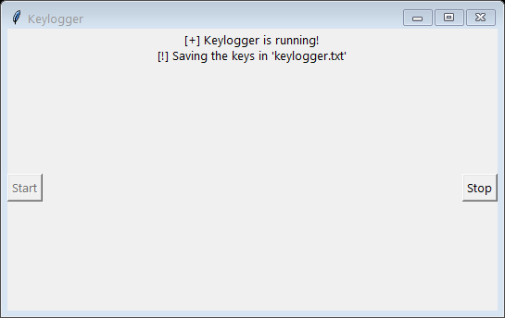
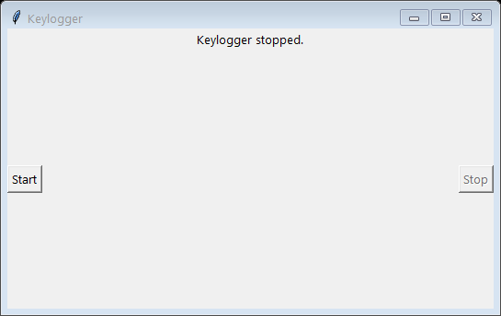
RESULT
After starting the keylogger
After clicking stop button

Slide 9
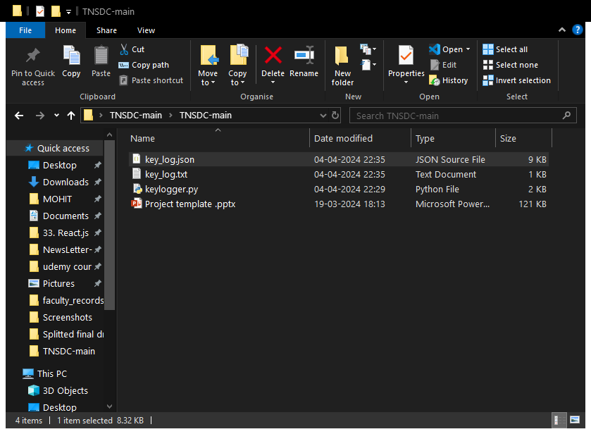
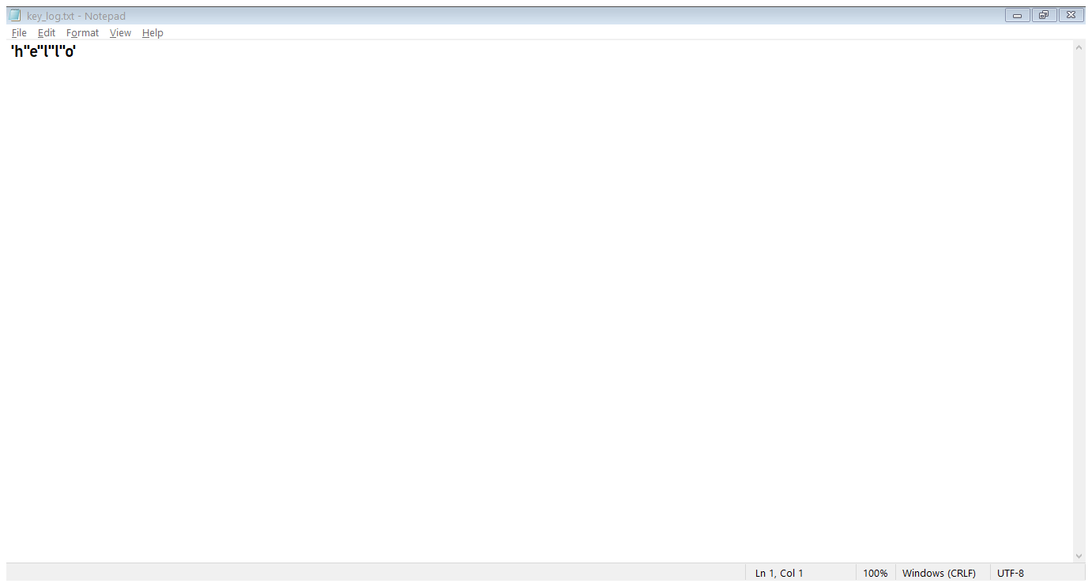
OUTPUT FILES
As you can see there are two files
Text file showing user keystroke “hello”

Slide 10
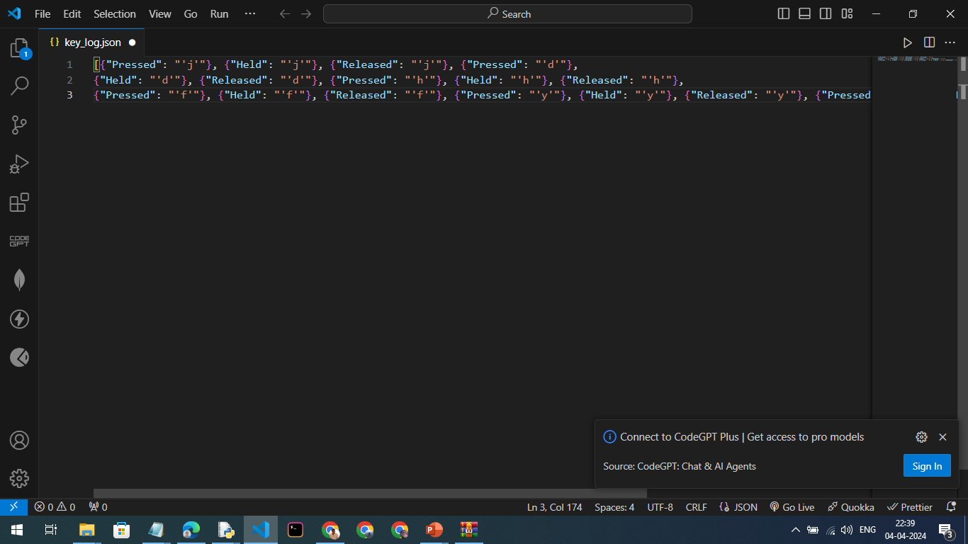
OUTPUT FILES
json file showing user’s keystroke

Slide 11
CONCLUSION
As a result we got to know about keylogger and how a hacker use it effectively to do a data breach using keylogger by finding our keystrokes.Now we can be aware of it and also we can use it for good purpose

Slide 12
FUTURE SCOPE
Parental Control and Monitoring: Keyloggers could be used as a tool for parents to monitor their children's online activities, ensuring their safety and protecting them from cyberbullying, online predators, or exposure to inappropriate content.
Employee Monitoring: In a workplace environment, keyloggers could be used by employers to monitor employee activities on company-owned devices to ensure compliance with company policies, prevent data breaches, and enhance productivity.
User Behavior Analysis: Keyloggers could be integrated into software applications to analyze user behavior and improve user experience. For example, tracking keystrokes in an educational software to understand how students interact with the system and identify areas for improvement.

Slide 13
REFERENCES
Wikipedia
Listening to the free course offered by naan mudhalvan-IBM(skillbuild)

Slide 14
THANK YOU

